Slide 1
Management Challenges

Slide 2
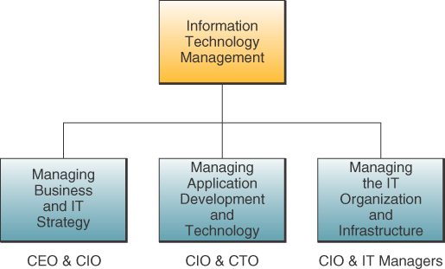
Components of IT Management
Chapter 14 Chapter 14 Enterprise and Global Management of Information Technology

Slide 3
Managing Information Technology
Managing the joint development and implementation of business and IT strategies
  Use IT to support strategic business priorities
  Align IT with strategic business goals
Managing the development and implementation of new business/IT applications and technologies
  IS development
Managing the IT organization and infrastructure
  Hardware, software, databases, networks, and other resources
Chapter 14 Chapter 14 Enterprise and Global Management of Information Technology

Slide 4
Managing Application Development
Application development management involves
  Systems analysis and design
  Prototyping
  Applications programming
  Project management
  Quality assurance
  System maintenance
Chapter 14 Chapter 14 Enterprise and Global Management of Information Technology

Slide 5
Managing IS Operations
IS operations management is concerned with the use of hardware, software, network, and personnel resources in data centers
Operational activities that must be managed
  Computer system operations
  Network management
  Production control
  Production support
Chapter 14 Chapter 14 Enterprise and Global Management of Information Technology

Slide 6
IT Staff Planning
Recruiting, training and retaining qualified
IS personnel
Evaluating employee job performance and rewarding outstanding performance with
salary increases and promotions
Setting salary and wage levels
Designing career paths
Chapter 14 Chapter 14 Enterprise and Global Management of Information Technology

Slide 7
Outsourcing
The purchase of goods or services from
third-party partners that were previously provided internally
Chapter 14 Chapter 14 Enterprise and Global Management of Information Technology

Slide 8
Why Outsource?
Save money – achieve greater ROI
Focus on core competencies – organizations
can focus on the business that they are in
Achieve flexible staffing levels
Gain access to global resources
Decrease time to market
Chapter 14 Chapter 14 Enterprise and Global Management of Information Technology

Slide 9
Offshoring
Relocation of an organization’s business processes to a lower cost location
  This location is typically overseas
  Can be either production or service
Growth of services offshoring is linked to
  Availability of large amounts of reliable
  and affordable communication infrastructure
  Digitization of many services
Chapter 14 Chapter 14 Enterprise and Global Management of Information Technology

Slide 10
Global IT Management Challenges
Political challenges
  Many countries regulate or prohibit the
  transfer of data across their national boundaries
  Others severely restrict, tax, or prohibit
  imports of hardware and software
  Some have local content laws that specify the portion of the value of a product that must be added in that country if it is to be sold there
  Others require a business to spend part of the revenue they earn in a country in that nation’s economy
Chapter 14 Chapter 14 Enterprise and Global Management of Information Technology

Slide 11
Global IT Management Challenges
Geo-economic challenges
  It is difficult to communicate in real time
  across 24 time zones
  Many countries do not have good telephone
  and telecommunications services
  It may be hard to find skilled local workers
  There can be great differences in the cost of living and labor costs between countries
Chapter 14 Chapter 14 Enterprise and Global Management of Information Technology

Slide 12
Global IT Management Challenges
Cultural challenges
  Languages
  Cultural interests
  Religions
  Customs
  Political philosophies
  Global IT managers need cultural training
  before they are sent on assignment
  Different work styles and business relationships
Chapter 14 Chapter 14 Enterprise and Global Management of Information Technology

Slide 13
IT Security, Ethics, and Society
IT has both beneficial and detrimental effects on society and people
  Manage work activities to minimize the detrimental effects of IT
  Optimize the beneficial effects
Chapter 13 Security and Ethical Challenges

Slide 14
Computer Crime
Computer crime includes
  Unauthorized use, access, modification, or destruction of hardware, software, data, or network resources
  The unauthorized release of information
  The unauthorized copying of software
  Denying an end user access to his/her own hardware, software, data, or network resources
  Using or conspiring to use computer or network resources illegally to obtain information or tangible property
Chapter 13 Security and Ethical Challenges

Slide 15
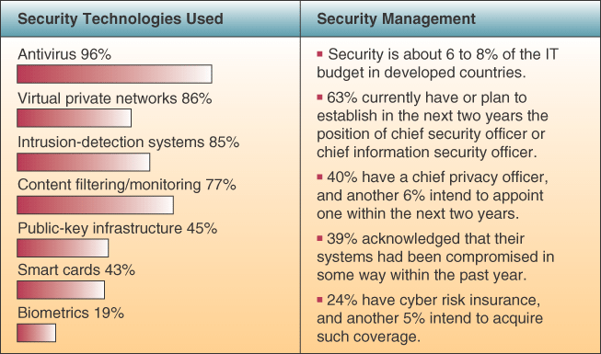
Cybercrime Protection Measures
Chapter 13 Security and Ethical Challenges

Slide 16
Cyber Theft
Many computer crimes involve the theft of money
The majority are “inside jobs” that involve unauthorized network entry and alternation of computer databases to cover the tracks of the employees involved
Many attacks occur through the Internet
Most companies don’t reveal that they have been targets or victims of cybercrime
Chapter 13 Security and Ethical Challenges

Slide 17
Viruses and Worms
A virus is a program that cannot work without being inserted into another program
  A worm can run unaided
These programs copy annoying or destructive routines into networked computers
  Copy routines spread the virus
Commonly transmitted through
  The Internet and online services
  Email and file attachments
  Disks from contaminated computers
  Shareware
Chapter 13 Security and Ethical Challenges

Slide 18
Privacy Issues
The power of information technology to store and retrieve information can have a negative effect on every individual’s right to privacy
  Personal information is collected with every
  visit to a Web site
  Confidential information stored by credit
  bureaus, credit card companies, and the government has been stolen or misused
Chapter 13 Security and Ethical Challenges

Slide 19
Protecting Your Privacy on the Internet
There are multiple ways to protect your privacy
  Encrypt email
  Ask your ISP not to sell your name and information to mailing list providers and
  other marketers
  Don’t reveal personal data and interests on
  online service and website user profiles
Chapter 13 Security and Ethical Challenges

Slide 20
Internetworked Security Defenses
Encryption
  Data is transmitted in scrambled form
  It is unscrambled by computer systems for authorized users only
  The most widely used method uses a pair of public and private keys unique to each individual
Chapter 13 Security and Ethical Challenges

Slide 21
Internetworked Security Defenses
Firewalls
  A gatekeeper system that protects a company’s intranets and other computer networks from intrusion
  Provides a filter and safe transfer point for
  access to/from the Internet and other networks
  Important for individuals who connect to the Internet with DSL or cable modems
  Can deter hacking, but cannot prevent it
Chapter 13 Security and Ethical Challenges

